Slide 1




Capstone Project II
BIG DATA
Presented By:
Shahad Alshahrani Ahmed Alrabghi Fares Alshalawi

Slide 2

Agenda
| | Project Objectives
| | Big Data & Azure
| | Machine Learning
| | Project Steps
| | Data Overview
| | Data Ingestion
| | Data Transformation
| | Data Visualization
| | System Overview

Slide 3
Project Objectives
What our capstone project aims to achieve is to build and manage data pipelines, transform data, and use machine learning techniques. We’ll be working with real-world data and tools on the Azure cloud platform.

Slide 4

Big Data & Azure
Big Data:
Refers to extremely large datasets that are too complex for traditional data processing tools such as using our own computers to process it.
Used for analyzing trends, patterns, and insights that help in decision-making.
Azure:
Azure is a cloud service by Microsoft that allows businesses to store data and run applications over the internet instead of on local computers, making it easier and more flexible to manage IT resources.

Slide 5
Big Data & Azure
Data pipeline:
It’s like a system of connected pipes that moves water from one place to another, but instead of water, it moves data.
It collects data from different sources, processes it, and delivers it to where it needs to go, making sure everything flows smoothly and efficiently.

Slide 6
Machine Learning
Machine learning:
Machine learning is a type of Artificial Intelligence where computers learn from data to make decisions or predictions without being explicitly programmed, similar to how humans learn from experience

Slide 7
Big Data and Machine Learning
Why We Used Them in Our Project:
Big Data:
We deal with a huge amount of data from StackOverflow by collecting more than 200GB of data daily , which needs special tools for storage and processing.
Machine Learning:
Helps us classify the topics of posts automatically, providing insights into the most discussed topics each day.

Slide 8
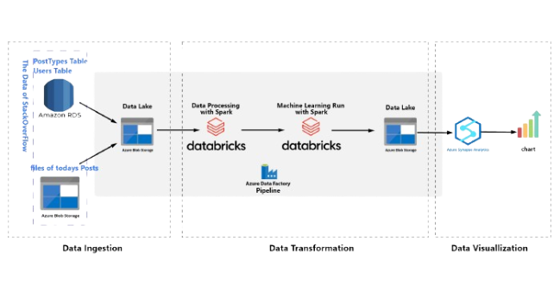
Project Steps
1- Data ingestion:
Collect and save data from multiple sources periodically
2- Data transformation:
Clean the data and feed it into the model for training
3- Data visualization:
Build an insightful data visualization and graphs

Slide 9


Data Overview
We needed to get 3 tables from 2 data sources, RDS and Azure Storage Blob Container.
RDS tables :
Users and PostTypes
We need to update them weekly
Storage Blob Container table:
Posts
We need to update it daily

Slide 10
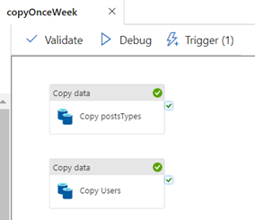
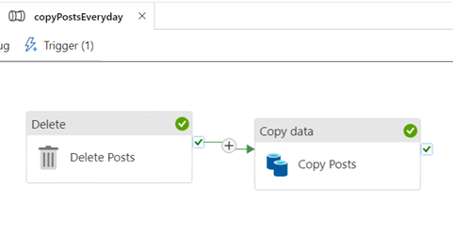
Data ingestion
In this step we are using Azure Data Factory (ADF) and it is an integration service that allows us to create, schedule, and orchestrate data workflows. Here’s how we used ADF to connect to our data sources
copyOnceWeek activity
copyPostsEveryday activity
We created two copy activities which will copy postTypes and Users tables to our storage blob
We created two activities one to copy Posts table and another to delete existing file before copying the new files

Slide 11
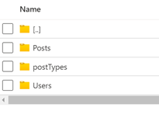
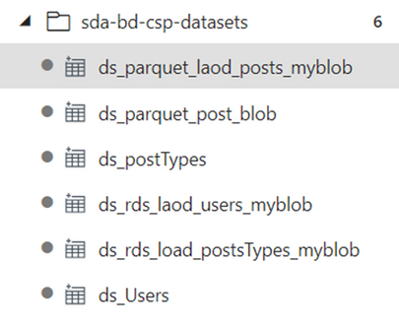
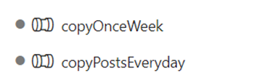
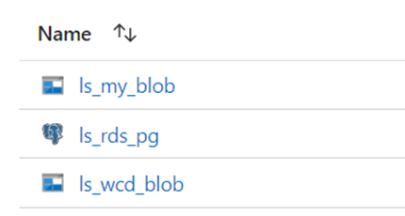
Data ingestion
Creating the data lake to store the ingested data files and build container and prepare the folders to accept the files
Bulid the pipelines in Data Factory we created 2 pipelines
"copyOnceWeek“
"copyPostsEveryday“
Creating 3 linked services for every item we plan to ingest from or write data to
Creating datasets we will have 6 datasets

Slide 12

Data transformation
We well work on Databricks for building and training our machine learning model , Databricks is a powerful platform for data engineering, machine learning, and analytics. Here's how we used Databricks to process our data .
The model training well be focused on building a machine learning model to classify the topics of StackOverflow posts by analyzing large volumes of text data, providing valuable insights and automating data-driven decision-making.

Slide 13
Data transformation
Create an Azure Databricks and ML model training
NEW SET OF SAMPLE DATA
TRAIN OUR ML MODEL USING THE SAMPLE DATA
NOW WE HAVE THE ACTUAL ML MODEL
PREDICTED OUTCOME
AZURE BLOB SRTORAGE - CONTAINS THE MODEL
NEW DATA BEING CONSUMED FROM PIPELINES

Slide 14
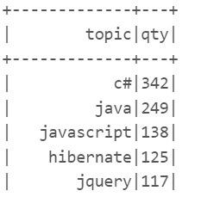
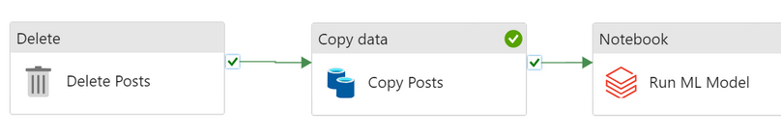
Data transformation
Now the model can classify each post into a specific topic based on the text .
We generated a report showing the top topics discussed on StackOverflow for the day , This was achieved by counting the number of posts in each topic and identifying the topics with the highest counts.
Then we Extracted the predicted topics and saved the results back to the Data Lake.

Slide 15
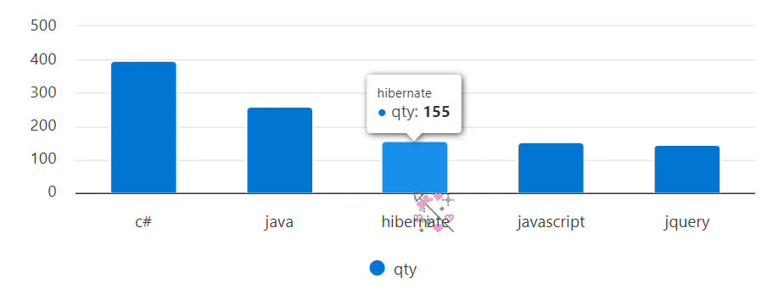
Data Visualization
we created a Synapse workspace and included our storage account containing the ML result file and the data we ingested to do data visualization and to gain some insights
We've fulfilled the business requirement by creating a column chart that showcases the top 5 topics in Stack Overflow posts, arranged in descending order. This chart effectively visualizes the most prominent topics within the Stack Overflow community.

Slide 16
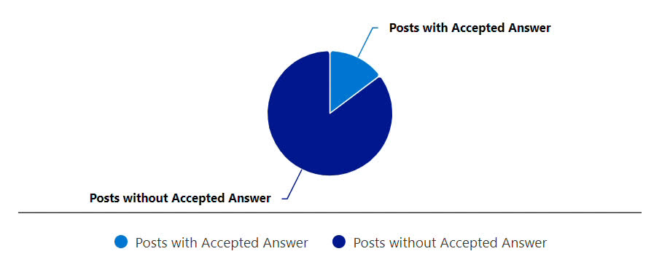
Data Visualization
In addition to meeting the business requirement, we've conducted a statistical analysis to illustrate the percentage of questions with accepted answers compared to those without. This analysis provides valuable insights into the engagement and resolution rates within the Stack Overflow platform.

Slide 17
System Overview

Slide 18
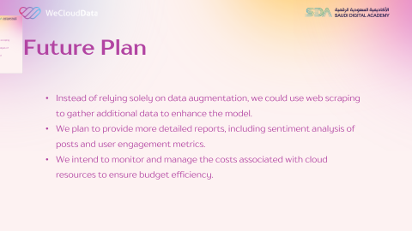
Future Plan
Instead of relying solely on data augmentation, we could use web scraping to gather additional data to enhance the model.
We plan to provide more detailed reports, including sentiment analysis of posts and user engagement metrics.
We intend to monitor and manage the costs associated with cloud resources to ensure budget efficiency.

Slide 19
Thank You
Shahad Alshahrani Ahmed Alrabghi Fares Alshalawi

